Slide 1
LCA of Tesla Lithium-ion battery with an NCA cathode
By Ollie Snelling - 2025754
Kieran Tsang - 2096492
Max Brett - 2045365
Samuel Payandee - 2040635
Kam Nasser - 2003530

Slide 2

Project Scope & Methodology
Aim was to evaluate a Li-ion 2170 cell battery system with a Nickel-Cobalt-Aluminium (NCA) cathode from an LCA perspective and present findings.
Cradle-to-grave model adopted to assess environmental impact of the whole product life cycle.
Functional Unit: Tesla Model 3 79.5kwh battery pack weighing 478kg
NCA Cathode Materials and Production
Remaining Battery Materials and Production
Transportation
Use Phase
End of Life
Life Cycle Costing
Cradle-to-grave LCA Model
Notes:
Kieran
Brush up the writing, look at the slides for functional units and perhaps change it there

Slide 3
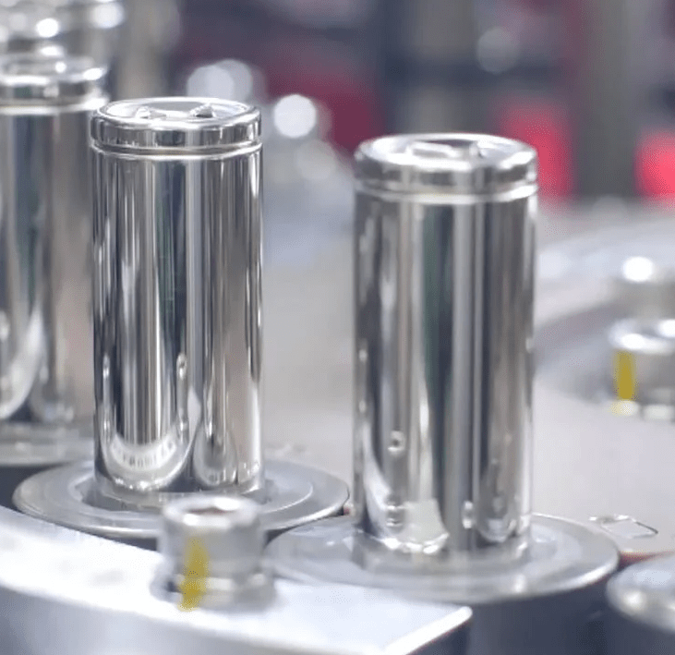
Production

Slide 4

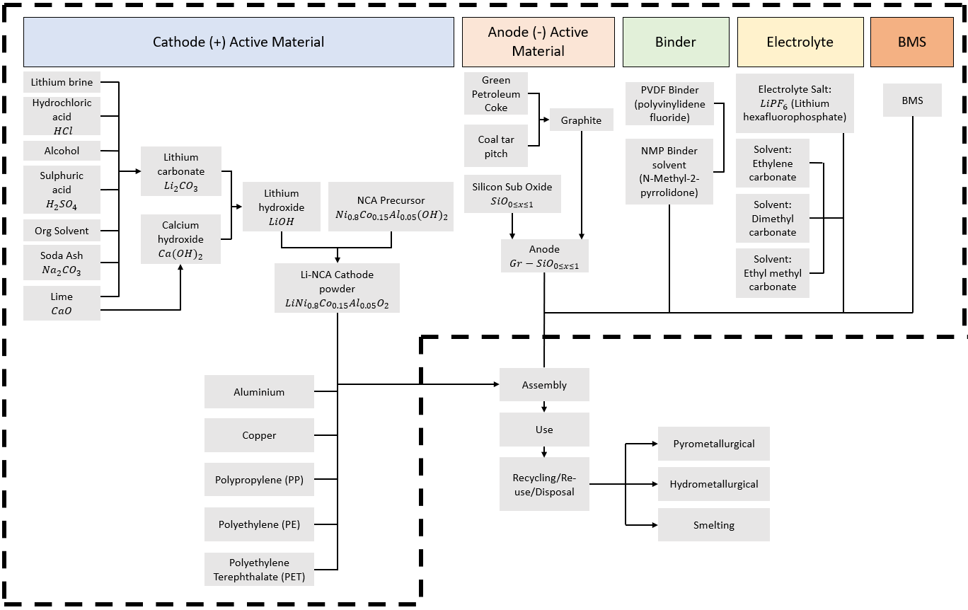
Overview of Whole Process
Introduction
NCA Cathode Production
Remaining Production
Transport
Use Phase
End of Life
Economic Life Cycle Costing
Notes:
Kieran
1 - Dunn, Jennifer B., et al. “Impact of Recycling on Cradle-To-Gate Energy Consumption and Greenhouse Gas Emissions of Automotive Lithium-Ion Batteries.” Environmental Science & Technology, vol. 46, no. 22, 30 Oct. 2012, pp. 12704–12710, https://doi.org/10.1021/es302420z. [Accessed 18th April 2023].
2 - Benavides, Pahola, et al. “Addition of Nickel Cobalt Aluminum (NCA) Cathode Material to GREET2 Pahola Thathiana Benavides%2C Qiang Dai%2C Jarod Kelly%2C Jennifer B. Dunn September 2016.” Bing, Sept. 2016, www.bing.com/search?q=Addition+of+nickel+cobalt+aluminum+(NCA)+cathode+material+to+GREET2+Pahola+Thathiana+Benavides%2C+Qiang+Dai%2C+Jarod+Kelly%2C+Jennifer+B.+Dunn+September+2016&cvid=630a736ffd4e4e02b11b75bd6f50e824&aqs=edge.0.69i59j69i64.462j0j9&FORM=ANAB01&PC=SCOOBE. [Accessed 19 Apr. 2023].
3 - Iyer, Rakesh. “Argonne GREET Publication : Updated Production Inventory for Lithium-Ion Battery Anodes for the GREET® Model, and Review of Advanced Battery Chemistries.” Greet.es.anl.gov, Oct. 2022, greet.es.anl.gov/publication-battery_anode_2022. [Accessed 18th April 2023].

Slide 5

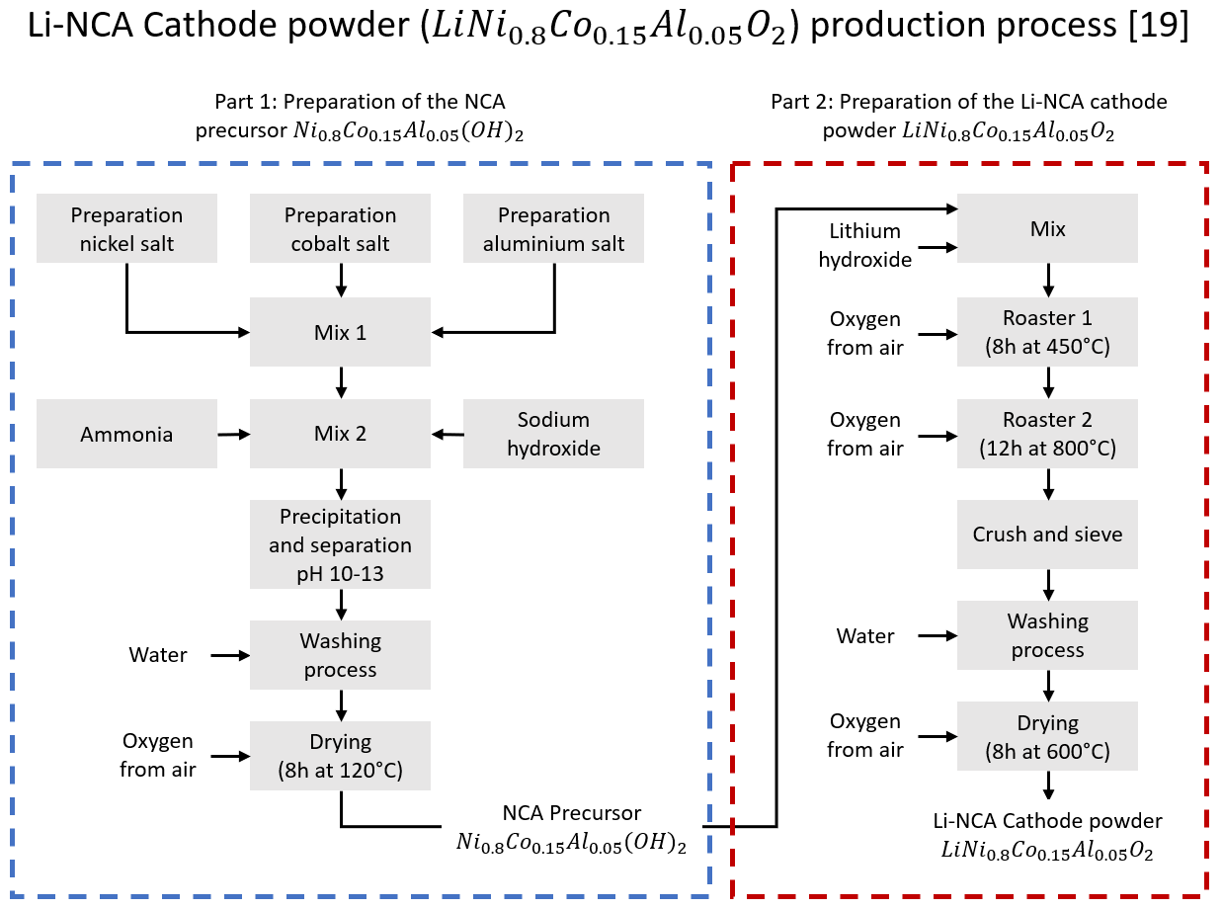
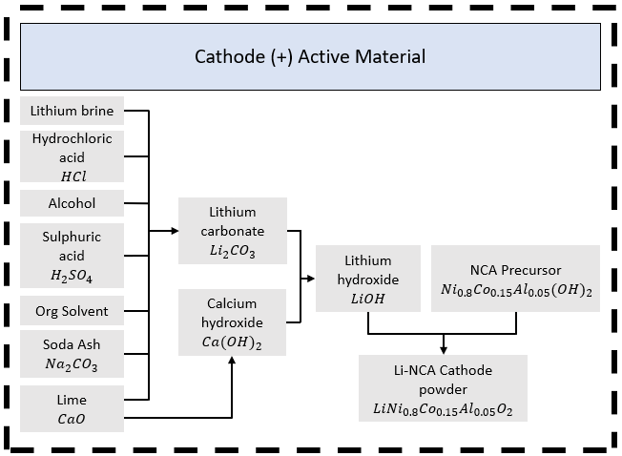
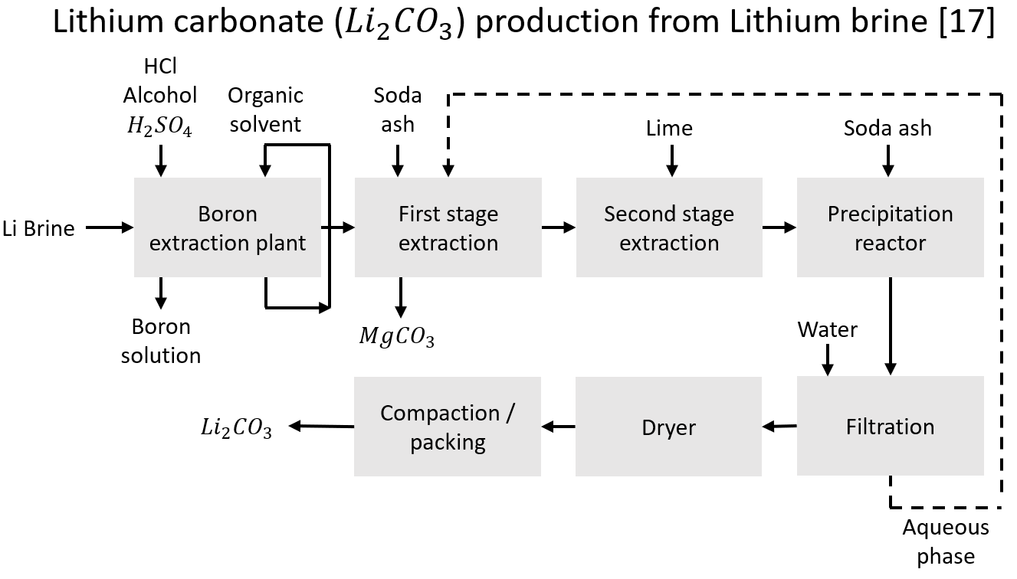
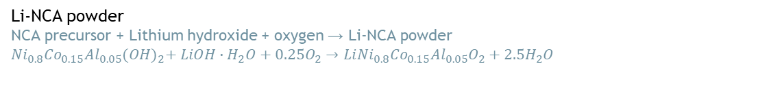
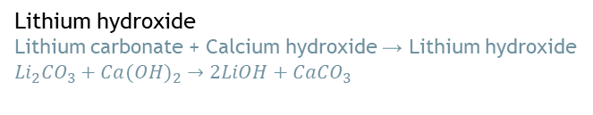
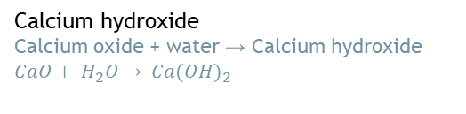
NCA Cathode Production
Introduction
NCA Cathode Production
Remaining Production
Transport
Use Phase
End of Life
Economic Life Cycle Costing
Calcium hydroxide
Calcium oxide + water → Calcium hydroxide
$CaO+ H_{2}O→ {Ca(OH)}_{2}$
Lithium hydroxide
Lithium carbonate + Calcium hydroxide → Lithium hydroxide
$${Li}_{2}{CO}_{3}+{Ca(OH)}_{2}→2LiOH+{CaCO}_{3}$$
Li-NCA powder
NCA precursor + Lithium hydroxide + oxygen → Li-NCA powder
$${Ni}_{0.8}{Co}_{0.15}{Al}_{0.05}{(OH)}_{2}+ LiOH∙H_{2}O+0.25O_{2}→Li{Ni}_{0.8}{Co}_{0.15}{Al}_{0.05}O_{2}+2.5H_{2}O$$
Notes:
Ollie
Following from the top level overview, process flow charts were found for each of the primary processes to manufacture the cathode
Understanding the processes involved allowed us to model the production processes within OpenLCA.
The process diagram on the right details the two key phases of the Li-NCA production process which is quantified by the next slide
1 - Dunn, Jennifer B., et al. “Impact of Recycling on Cradle-To-Gate Energy Consumption and Greenhouse Gas Emissions of Automotive Lithium-Ion Batteries.” Environmental Science & Technology, vol. 46, no. 22, 30 Oct. 2012, pp. 12704–12710, https://doi.org/10.1021/es302420z. [Accessed 18th April 2023].
2 - Benavides, Pahola, et al. “Addition of Nickel Cobalt Aluminum (NCA) Cathode Material to GREET2 Pahola Thathiana Benavides%2C Qiang Dai%2C Jarod Kelly%2C Jennifer B. Dunn September 2016.” Bing, Sept. 2016, www.bing.com/search?q=Addition+of+nickel+cobalt+aluminum+(NCA)+cathode+material+to+GREET2+Pahola+Thathiana+Benavides%2C+Qiang+Dai%2C+Jarod+Kelly%2C+Jennifer+B.+Dunn+September+2016&cvid=630a736ffd4e4e02b11b75bd6f50e824&aqs=edge.0.69i59j69i64.462j0j9&FORM=ANAB01&PC=SCOOBE. [Accessed 19 Apr. 2023].
3 - Iyer, Rakesh. “Argonne GREET Publication : Updated Production Inventory for Lithium-Ion Battery Anodes for the GREET® Model, and Review of Advanced Battery Chemistries.” Greet.es.anl.gov, Oct. 2022, greet.es.anl.gov/publication-battery_anode_2022. [Accessed 18th April 2023].

Slide 6

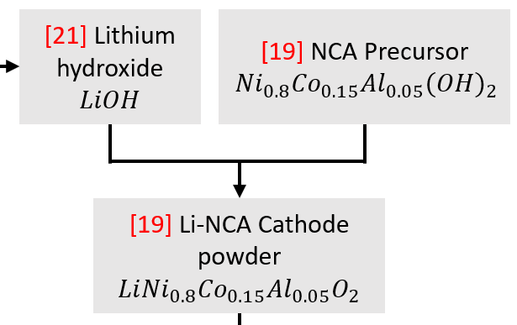

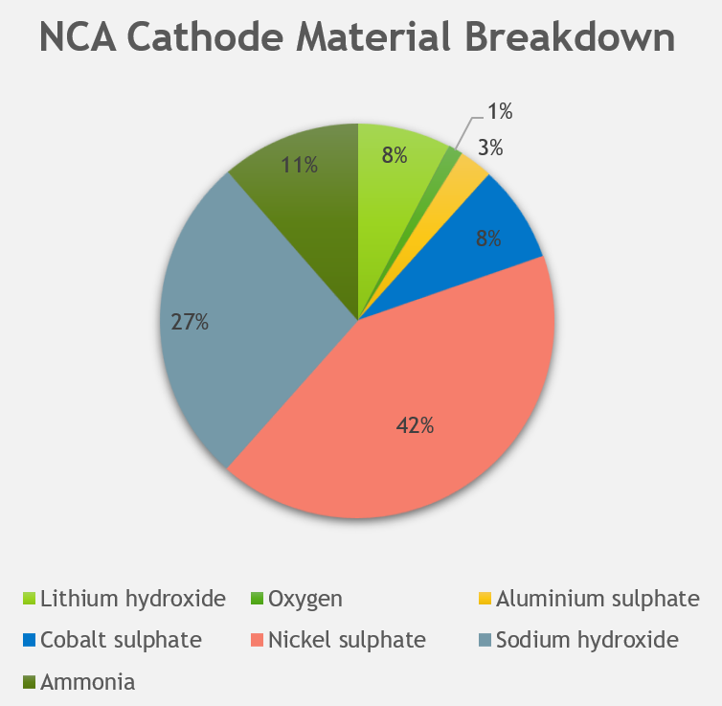
Material & Energy Used to Produce NCA Cathode
Introduction
NCA Cathode Production
Remaining Production
Transport
Use Phase
End of Life
Economic Life Cycle Costing
NCA Precursor (Top)
Li-NCA Cathode (Bottom)
NCA precursor material breakdown
Resource | Ton/Ton of precursor | Mass (%) | Mass (kg) (Referenced to 141.68kg NCA precursor
Aluminium sulphate | 0.09 | 3.0 | 4.31
Cobalt sulphate | 0.26 | 8.8 | 12.44
Nickel sulphate | 1.36 | 45.9 | 65.10
Sodium hydroxide | 0.88 | 29.7 | 42.12
Ammonia | 0.37 | 12.5 | 17.71
sum | 2.96 | 100.0 | 141.68
NCA precursor energy breakdown
Energy/ton (mmBtu) | Energy/ton (kWh) | Energy/battery pack, 141.66kg (kWh) | Share (%)
Electricity
0.04 | 11.72 | 1.66 | 25
Natural Gas
0.12 | 35.17 | 4.98 | 75
Li-NCA Cathode active material, material breakdown
Resource | Ton/Ton of Li-NCA | Mass (%) | Mass (kg) (Referenced to 184.93kg cathode active material
NCA Precursor | 0.95 | 76.6 | 141.68
Lithium hydroxide | 0.25 | 20.2 | 37.28
Oxygen | 0.04 | 3.2 | 5.97
sum | 1.24 | 100 | 184.93
Li-NCA Cathode active material energy breakdown
Energy/ton (mmBtu) | Energy/ton (kWh) | Energy/battery pack, 184.93kg (kWh) | Share (%)
Electricity
1.51 | 442.56 | 81.84 | 100
Notes:
Ollie RHS
The materials and energy requirements of the NCA precursor is quantified in the blue table.
And the second mixing phase which introduces the lithium hydroxide is quantified by the red table.
The tables also demonstrate the losses at each stage with 2.96 ton of material needed to produce 1 ton of precursor and 1.24 ton of material needed to produce 1 ton of Li-NCA.
Kieran LHS
1 - Benavides, Pahola, et al. “Addition of Nickel Cobalt Aluminum (NCA) Cathode Material to GREET2 Pahola Thathiana Benavides%2C Qiang Dai%2C Jarod Kelly%2C Jennifer B. Dunn September 2016.” Bing, Sept. 2016, www.bing.com/search?q=Addition+of+nickel+cobalt+aluminum+(NCA)+cathode+material+to+GREET2+Pahola+Thathiana+Benavides%2C+Qiang+Dai%2C+Jarod+Kelly%2C+Jennifer+B.+Dunn+September+2016&cvid=630a736ffd4e4e02b11b75bd6f50e824&aqs=edge.0.69i59j69i64.462j0j9&FORM=ANAB01&PC=SCOOBE. [Accessed 19 Apr. 2023].
2 - Porzio, Jason, and Corinne D. Scown. “Life‐Cycle Assessment Considerations for Batteries and Battery Materials.” Advanced Energy Materials, vol. 11, no. 33, 14 July 2021, p. 2100771, https://doi.org/10.1002/aenm.202100771. table data
3 - EVSpecifications. “2021 Tesla Model 3 Long Range AWD - Specifications.” EVSpecifications, 2022, www.evspecifications.com/en/model/445a110. Accessed 18 Apr. 2023.

Slide 7
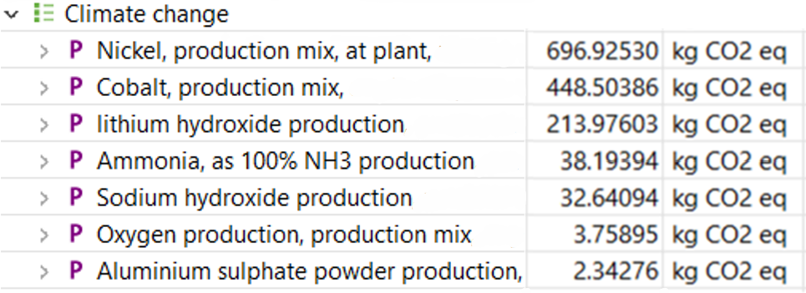

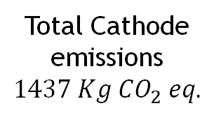
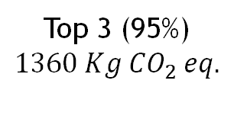
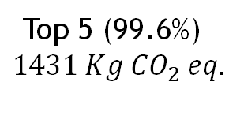
Introduction
NCA Cathode Production
Remaining Production
Transport
Use Phase
End of Life
Economic Life Cycle Costing
NCA Cathode Production Impact Analysis
Li-NCA cathode material breakdown
Resource | Mass (%) | Mass (kg) (Referenced to 184.93kg cathode active material)
Nickel sulphate | 35.2 | 65.10
Cobalt sulphate | 6.7 | 12.44
Aluminium sulphate | 2.3 | 4.31
Sodium hydroxide | 22.8 | 42.12
Ammonia | 9.6 | 17.71
Lithium hydroxide | 20.2 | 37.28
Oxygen | 3.2 | 5.97
Top 3 (95%)
$$1360 Kg {CO}_{2} eq.$$
Top 5 (99.6%)
$$1431 Kg {CO}_{2} eq.$$
Total Cathode emissions
$$1437 Kg {CO}_{2} eq.$$
Notes:
Kieran
1 - Benavides, Pahola, et al. “Addition of Nickel Cobalt Aluminum (NCA) Cathode Material to GREET2 Pahola Thathiana Benavides%2C Qiang Dai%2C Jarod Kelly%2C Jennifer B. Dunn September 2016.” Bing, Sept. 2016, www.bing.com/search?q=Addition+of+nickel+cobalt+aluminum+(NCA)+cathode+material+to+GREET2+Pahola+Thathiana+Benavides%2C+Qiang+Dai%2C+Jarod+Kelly%2C+Jennifer+B.+Dunn+September+2016&cvid=630a736ffd4e4e02b11b75bd6f50e824&aqs=edge.0.69i59j69i64.462j0j9&FORM=ANAB01&PC=SCOOBE. [Accessed 19 Apr. 2023].
2 - Porzio, Jason, and Corinne D. Scown. “Life‐Cycle Assessment Considerations for Batteries and Battery Materials.” Advanced Energy Materials, vol. 11, no. 33, 14 July 2021, p. 2100771, https://doi.org/10.1002/aenm.202100771. table data
3 - EVSpecifications. “2021 Tesla Model 3 Long Range AWD - Specifications.” EVSpecifications, 2022, www.evspecifications.com/en/model/445a110. Accessed 18 Apr. 2023.

Slide 8

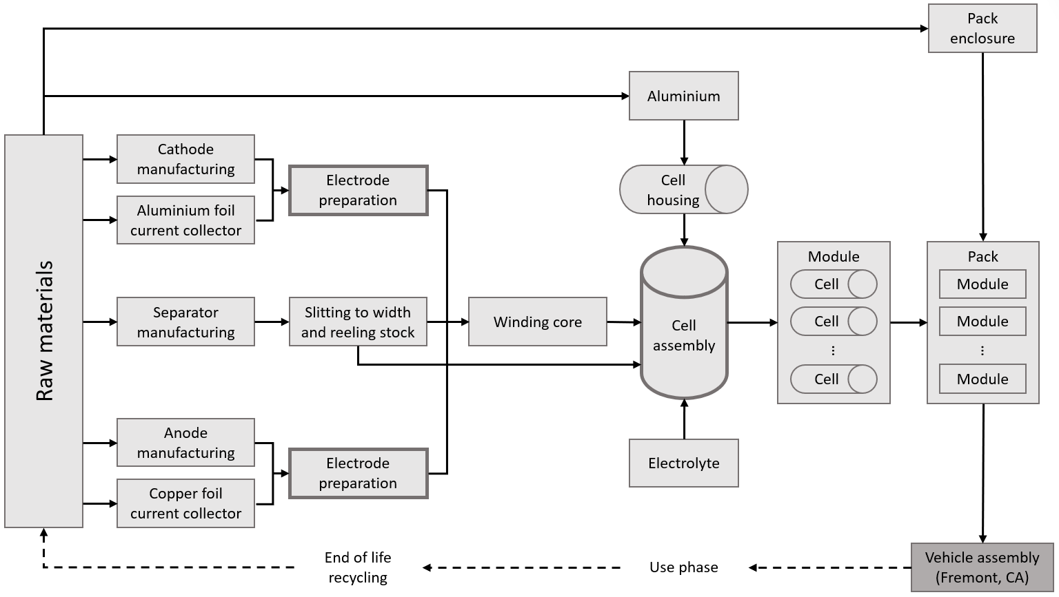
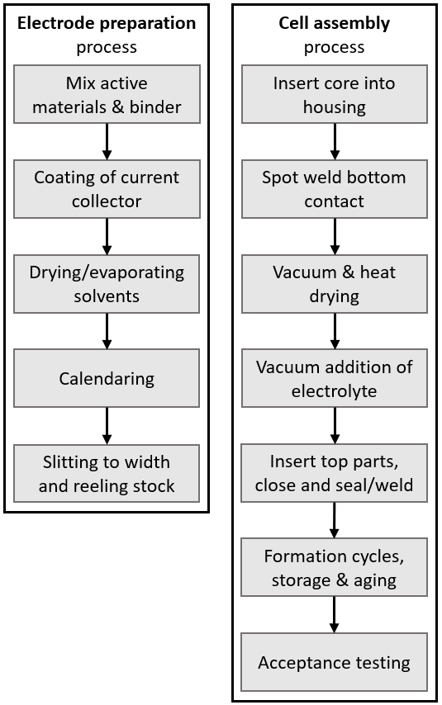
Introduction
NCA Cathode Production
Remaining Production
Transport
Use Phase
End of Life
Economic Life Cycle Costing
Overview for Remaining Production
Notes:
Ollie
With the cathode modelled, we moved onto the remaining production.
This process overview demonstrates the top-level processes to produce the battery pack which, once assembled is sent to Tesla’s Fremont factory for vehicle assembly.
The key processes within this model are the electrode preparation and cell assembly which are detailed on the right.
A mass breakdown for each of these processes were found and referenced to the mass of the battery pack for use in our LCA.
1 - Gaines, Linda , et al. “Life Cycle Analysis for Lithium Ion Battery Production and Recycling .” ResearchGate, Jan. 2011, https://www.researchgate.net/publication/265158823_Paper_No_11-3891_Life-Cycle_Analysis_for_Lithium-Ion_Battery_Production_and_Recycling. [Accessed 20th April 2023]
2 - Strategy for Executives. “Tesla’s Gigafactory.” Strategy for Executives, 2019, strategyforexecs.com/tesla-gigafactory/. Accessed 20th Apr. 2023.

Slide 9
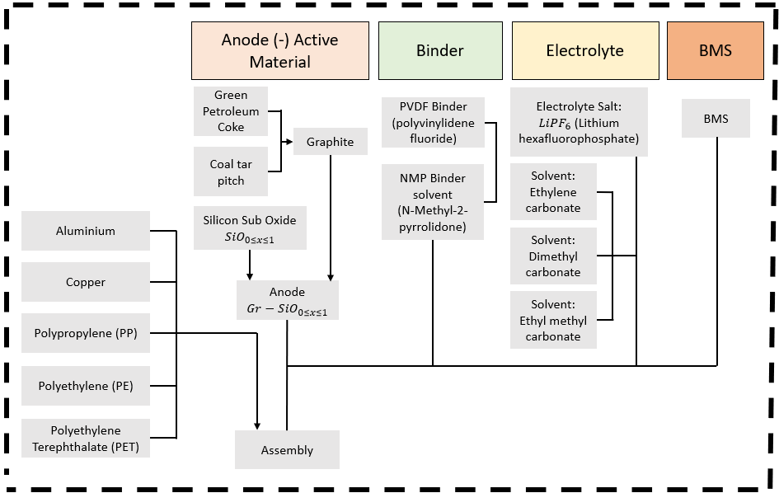
Introduction
NCA Cathode Production
Remaining Production
Transport
Use Phase
End of Life
Economic Life Cycle Costing
Remaining Production LCA data
Resource | Use | Mass (g/kWh) | Mass (kg) (Referenced to battery pack = 79.5kWh) | Mass (kg) (Scaled to full 478kg pack)
Cathode active material | Cathode | 1358.7 | 108.02 | 184.93
Graphite | anode | 857.71 | 68.19 | 116.74
Silicon suboxide | anode | 39.45 | 3.14 | 5.37
polyvinylidene fluoride (PVDF) | Cathode binder | 28.31 | 2.25 | 3.85
 | Anode binder | 17.5 | 1.39 | 2.38
N-Methyl-2-pyrrolidone (NMP) | Binder solvent | 45.81 | 3.64 | 6.24
Lithium hexafluorophosphate (LiPF6) | Electrolyte salt | 2.4 | 0.19 | 0.33
Ethylene carbonate | Electrolyte fluid | 190.14 | 15.12 | 25.88
Dimethyl carbonate | Electrolyte fluid | 154.13 | 12.25 | 20.98
Ethyl methyl carbonate | Electrolyte fluid | 154.13 | 12.25 | 20.98
Misc electronics | BMS | 11.05 | 0.88 | 1.50
Aluminium | Cathode current collector | 79.12 | 6.29 | 10.77
 | Positive terminal assembly | 27.05 | 2.15 | 3.68
 | Cell container | 51.48 | 4.09 | 7.01
 | Module heat conductors | 91.67 | 7.29 | 12.48
 | Module enclosure | 63.57 | 5.05 | 8.65
Copper | Anode current collector | 186.31 | 14.81 | 25.36
 | Negative terminal assembly | 89.75 | 7.14 | 12.22
 | Cell interconnection | 26.85 | 2.13 | 3.65
Polypropylene (PP) | Seperator | 12.73 | 1.01 | 1.73
 | Cell container | 7.89 | 0.63 | 1.07
Polyethylene (PE) | Seperator | 12.73 | 1.01 | 1.73
Polyethylene Terephthalate (PET) | Cell container | 3.43 | 0.27 | 0.47
Notes:
Ollie
The table shows the mass breakdown for each material and its use which we used to model the total emissions within OpenLCA.
Assumptions
Due to the complexity of electrical components in the BMS and its minor mass of only 1.5kg, we excluded in our LCA since this would require primary sources of information which we don’t have access to.
Silicon suboxide was added at a mass of 4.6% of the graphite mass based on a material decomposition of a 2170 cell anode.
1 - Porzio, Jason, and Corinne D. Scown. “Life‐Cycle Assessment Considerations for Batteries and Battery Materials.” Advanced Energy Materials, vol. 11, no. 33, 14 July 2021, p. 2100771, https://doi.org/10.1002/aenm.202100771.
2 - Zülke, A., Li, Y., Keil, P., Burrell, R., Belaisch, S., Nagarathinam, M., Mercer, M.P. and Hoster, H.E. (2021). High‐Energy Nickel‐Cobalt‐Aluminium Oxide (NCA) Cells on Idle: Anode‐ versus Cathode‐Driven Side Reactions. Batteries & Supercaps, 4(6), pp.934–947. doi:https://doi.org/10.1002/batt.202100046.
3 - EVSpecifications. “2021 Tesla Model 3 Long Range AWD - Specifications.” EVSpecifications, 2022, www.evspecifications.com/en/model/445a110. Accessed 18 Apr. 2023.

Slide 10
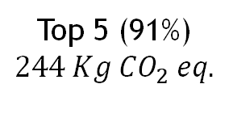
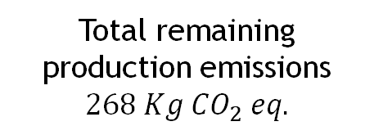
Remaining Production Impact Analysis
Introduction
NCA Cathode Production
Remaining Production
Transport
Use Phase
End of Life
Economic Life Cycle Costing
Resource | Use | Mass (kg) (Scaled to full 478kg pack)
Cathode active material | Cathode | 184.93
Graphite | anode | 116.74
Silicon suboxide | anode | 5.37
polyvinylidene fluoride (PVDF) | Cathode binder | 3.85
 | Anode binder | 2.38
N-Methyl-2-pyrrolidone (NMP) | Binder solvent | 6.24
Lithium hexafluorophosphate (LiPF6 ) | Electrolyte salt | 0.33
Ethylene carbonate | Electrolyte fluid | 25.88
Dimethyl carbonate | Electrolyte fluid | 20.98
Ethyl methyl carbonate | Electrolyte fluid | 20.98
Misc electronics | BMS | 1.50
Aluminium | Cathode current collector | 10.77
 | Positive terminal assembly | 3.68
 | Cell container | 7.01
 | Module heat conductors | 12.48
 | Module enclosure | 8.65
Copper | Anode current collector | 25.36
 | Negative terminal assembly | 12.22
 | Cell interconnection | 3.65
Polypropylene (PP) | Seperator | 1.73
 | Cell container | 1.07
Polyethylene (PE) | Seperator | 1.73
Polyethylene Terephthalate (PET) | Cell container | 0.47
Top 5 (91%)
$$244 Kg {CO}_{2} eq.$$
Total remaining production emissions
$$268 Kg {CO}_{2} eq.$$
Notes:
Ollie
This impact analysis shows the top 5 emissions found by our LCA which totalled 91% of the total production emissions excluding the Li-NCA production.
The top 5 impacts are the binder its solvent and the electrolyte solvents showing that the mixing process generates most of the emissions.
We found that the remaining production emissions are significantly lower than the cathode production emissions which can be attributed to the low environmental impact of the graphite anode.
1 - Porzio, Jason, and Corinne D. Scown. “Life‐Cycle Assessment Considerations for Batteries and Battery Materials.” Advanced Energy Materials, vol. 11, no. 33, 14 July 2021, p. 2100771, https://doi.org/10.1002/aenm.202100771.
2 - Zülke, A., Li, Y., Keil, P., Burrell, R., Belaisch, S., Nagarathinam, M., Mercer, M.P. and Hoster, H.E. (2021). High‐Energy Nickel‐Cobalt‐Aluminium Oxide (NCA) Cells on Idle: Anode‐ versus Cathode‐Driven Side Reactions. Batteries & Supercaps, 4(6), pp.934–947. doi:https://doi.org/10.1002/batt.202100046.
3 - EVSpecifications. (n.d.). 2021 Tesla Model 3 Long Range AWD - Specifications. [online] Available at: https://www.evspecifications.com/en/model/445a110.

Slide 11

Transport

Slide 12
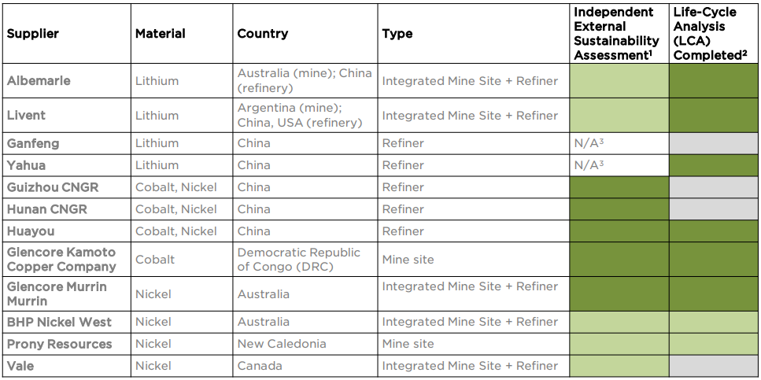
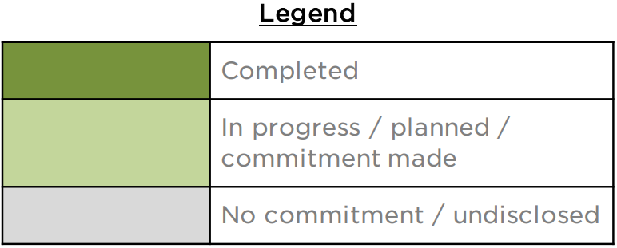
Tesla’s Battery Supply Chain
Data pulled from Tesla’s 2021 Impact Report
Notes:
In order to analyse the transportation emissions within the different processes of our NCA battery, a series of assumptions were made throughout in order to simplify and better understand the bigger picture:
To begin with, given our NCA battery of choice was the 2170 made by Tesla for their model 3, we researched the details of their supply chain for their battery production, eventually finding the undisclosed information available on their 2021 impact report. We decided to focus on the transportation of the 5 key most important elements for the production of the battery, Nickel, Cobalt, Aluminium, Lithium and Graphite.
As seen in the table on the screen, there are a series of different suppliers for the same materials so we assumed that each of the elements would come from one single individual supplier. Further assumptions will be discussed in the following slides.
Some of the general assumptions made for all materials include the fact that for each transportation the weight considered will be the amount each material makes up of one battery pack. As well as this, most of the distances and routes were calculated with the help of sea rates and google maps. As well as this, every time the any cargo arrived to Nevada, the final destination was chosen to be the City of Nevada, as Tesla’s factory is located here.
Combination of both sea rates and google maps to find out distances and time taken
Assumption of 1 supplier per material
Calculations for one shipment only
Cargo consists of the amount of materials needed for the production of one battery pack
Port of Nevada to city of Nevada
Assumption of lorry instead of freight train because of poor connection
Same RNA lorries, even for the abroad transport
References:
Tesla (2021). Impact | Tesla United Kingdom. [online] Tesla. Available at: https://www.tesla.com/en_gb/impact.
Firm, M.L. (2022). Why Do We Use Semi-Trucks And Not Trains? [online] McArthur Law Firm. Available at: https://mcarthurlawfirm.com/blog/2022/04/why-do-we-use-semi-trucks-and-not-trains/#:~:text=For%20numerous%20reasons%2C%20putting%20goods.
‌

Slide 13

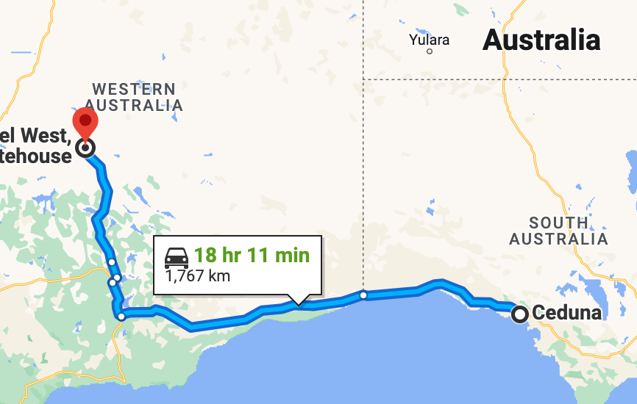

Transport - Nickel
Introduction
NCA Cathode Production
Remaining Production
Transport
Use Phase
End of Life
Economic Life Cycle Costing
Supplier | Location | Distance | Transport | Emissions | Total Emissions
Bhp West Nickel | Extraction Mine to Thevernard Port | 1767 km | Lorry | 6.55 Kg CO2 | 24.32 Kg CO eq
 | Thevernard Port to Nevada Port | 14331.05 km | Sea Freight | 17.52 Kg CO2
 | Nevada Port to City of Nevada | 66.3 km | Lorry | 0.24 Kg CO2
Notes:
For the transportation of nickel, one of, if not the biggest supplier of choice for Tesla currently is BHP West Nickel, who holds operations in Australia, one of the largest Nickel reserves in the world. As such, the assumption was made that the Nickel was extracted at BHP’s facilities, then transported by lorry to the the Thevenard Port in south Australia, and from there shipped overseas to Nevada, where it is then transported to the city of Nevada.
The total emissions produced from this process amounted to around 24 kg, with sea freight contributing more yet, proportionately, lorry transportation emits notably more.
3 Transports – Lorry RAS, Lorry RNA, Sea Freight ROW
References:
Tesla (2021). Impact | Tesla United Kingdom. [online] Tesla. Available at: https://www.tesla.com/en_gb/impact.
Sanderson, H. (2021). Tesla signs nickel deal with BHP to secure non-Chinese supply. Financial Times. [online] 21 Jul. Available at: https://www.ft.com/content/250d6dc7-d6e2-47d0-b76e-a9abaab5eeae.
Bhp.com. (2021). BHP enters into nickel supply agreement with Tesla Inc. [online] Available at: https://www.bhp.com/news/media-centre/releases/2021/07/bhp-enters-into-nickel-supply-agreement-with-tesla-inc.
DP World (2010). Distances & Time. [online] SeaRates. Available at: https://www.searates.com/services/distances-time/.
‌

Slide 14
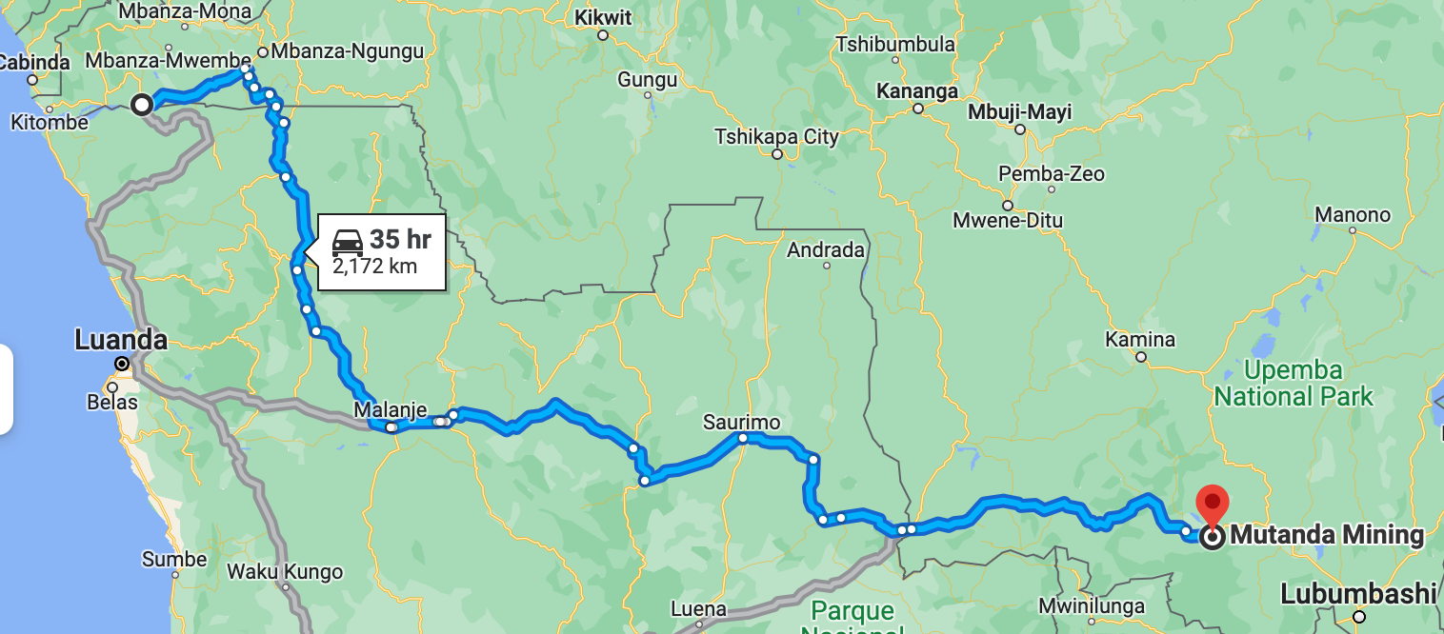
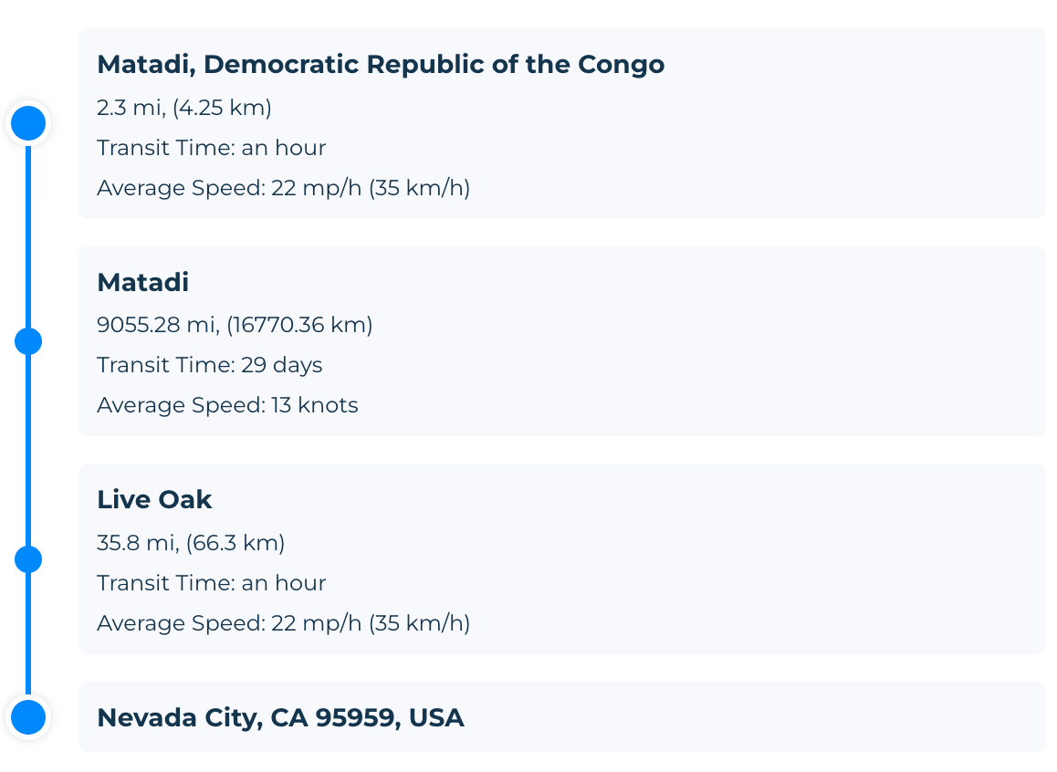
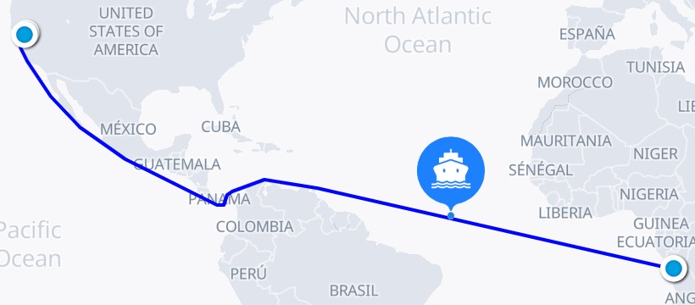
Transport – Cobalt
Introduction
NCA Cathode Production
Remaining Production
Transport
Use Phase
End of Life
Economic Life Cycle Costing
Supplier | Location | Distance | Transport | Emissions | Total Emissions
Glencore | Democratic Republic of Congo to Matadi Port | 2172km | Lorry | 1.56 Kg CO2 eq | 5.39 Kg CO2 eq
 | Matadi Port to Nevada Port | 16770.36km | Sea freight | 3.76 Kg CO2 eq
 | Nevada Port to City | 66.3km | Lorry | 0.045 Kg CO2 eq
Notes:
Cobalt is a mineral which is most abundant in the Democratic Republic of Congo, and as such, Tesla’s main Cobalt supplier – Glencore, sources its minerals from here. The transportation involves the movement from the mines, which are assumed to be taken from the location provided by Sea Rates, to the port of Matadi, and from here to the port of Nevada. This comes as a result of Glencore’s mines being located in the Lualaba province, Once again, the cargo is then transported to the city of Nevada as a representation of Tesla’s Factory.
The total emissions produced sum up to a total of almost 6kg of CO2 emissions, which, although may seem notably less than other materials despite the long distance travelled, a main contributing factor is the weight of cobalt as it equates to only 12kg
3 transports - RAF lorry, RNA lorry, Sea Freight ROW
References:
Tesla (2021). Impact | Tesla United Kingdom. [online] Tesla. Available at: https://www.tesla.com/en_gb/impact.
Smith, J. (2023). Harrowing images of cobalt mines in Congo where kids dig for $2-a-day. [online] Mail Online. Available at: https://www.dailymail.co.uk/news/article-11668015/Devastating-photos-cobalt-mines-Democratic-Republic-Congo-power-Apple-Tesla-more.html.
‌Ohnsman, A. (n.d.). Battery Push By Tesla And Other EV Makers Raises Child Labor Concerns. [online] Forbes. Available at: https://www.forbes.com/sites/alanohnsman/2023/02/08/battery-push-by-tesla-and-other-ev-makers-raises-child-labor-concerns/.
‌www.glencore.com. (n.d.). Cobalt. [online] Available at: https://www.glencore.com/what-we-do/metals-and-minerals/cobalt#:~:text=DRC [Accessed 8 May 2023].
DP World (2010). Distances & Time. [online] SeaRates. Available at: https://www.searates.com/services/distances-time/.
‌

Slide 15
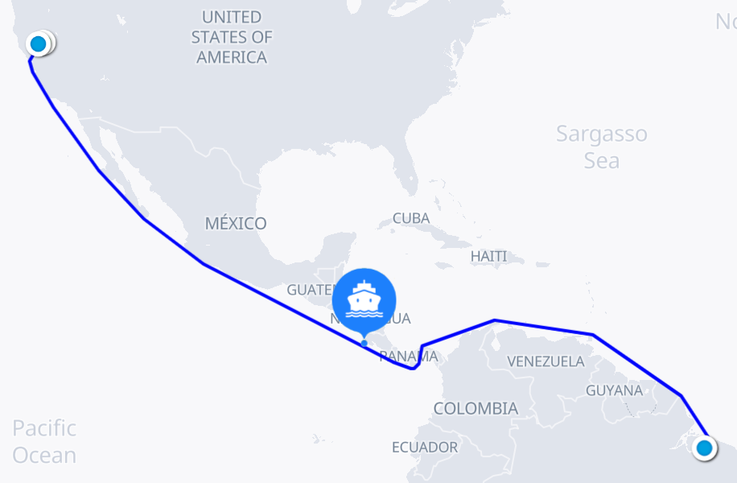
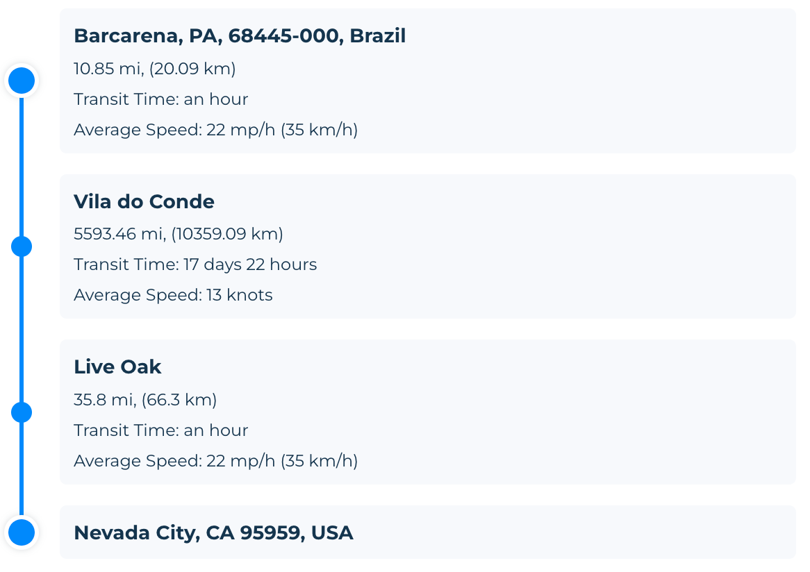
Transport – Aluminium
Introduction
NCA Cathode Production
Remaining Production
Transport
Use Phase
End of Life
Economic Life Cycle Costing
Supplier | Location | Distance | Transport | Emissions | Total Emissions
Norsk Hydro | Extraction Mine to Alunorte Port | 20.9 km | Lorry | 0.052 Kg CO2 | 9.36 KG CO2
 | Alunorte Port to Nevada Port | 10359.09 km | Sea freight | 9.14 Kg CO2
 | Nevada Port to City of Nevada | 66.3km | Lorry | 0.18 Kg CO2
Notes:
Aluminium has a catch as opposed to other materials however, as it first is extracted as bauxite and then converted to alumina, eventually becoming aluminium. For this, different sources stated Tesla’s principal aluminium supplier is Norsk Hydro, a giant Norweigan aluminium company with operations at global scale. Finding the exact location from which aluminium is sourced for tesla ended up being a more complex task as opposed to other metals due to the lack of information available, yet the process took forward was to look at Norsk Hydro’s facilities and which ones extracted AND processed bauxite to turn into aluminium.
As a result, Hydro Alunorte is the world's largest alumina refinery outside China and is located in the city of Barcarena, state of Pará. The alumina is the raw material for aluminum and is produced from bauxite, through the process called Bayer. – With this, we can safely assume the material is transported to Alunortes port, then to Nevada’s port and finally the city of Nevada
With a total emissions of 9.36 Kg of CO2
References:
Tesla (2021). Impact | Tesla United Kingdom. [online] Tesla. Available at: https://www.tesla.com/en_gb/impact.
Kolodny, L. (n.d.). Tesla has bought aluminum from Russian company Rusal since 2020, showing how war complicates supply chain. [online] CNBC. Available at: https://www.cnbc.com/2022/03/14/tesla-has-bought-aluminum-from-russian-supplier-rusal-since-2020.html#:~:text=According%20to%20Hydro [Accessed 8 May 2023].
‌
feeco (2019). The Transformation of Bauxite to Aluminum (and the Products in Between). [online] feeco.com. Available at: https://feeco.com/the-transformation-of-bauxite-to-aluminum-and-the-products-in-between/#:~:text=Aluminum%20starts%20out%20as%20bauxite [Accessed 8 May 2023].
‌
www.hydro.com. (n.d.). Brazil. [online] Available at: https://www.hydro.com/en/about-hydro/hydro-worldwide/north-america/brazil/ [Accessed 8 May 2023].
‌
www.hydro.com. (n.d.). Hydro Bauxite & Alumina. [online] Available at: https://www.hydro.com/en/about-hydro/management-and-organization/organization-overview/bauxite-and-alumina/ [Accessed 8 May 2023].
‌
Lambert, F. (2017). Tesla Model 3: aluminum part supplier announces investment to increase output ahead of Model 3 production. [online] Electrek. Available at: https://electrek.co/2017/02/20/tesla-model-3-aluminum-part-supplier-invest-production/.
DP World (2010). Distances & Time. [online] SeaRates. Available at: https://www.searates.com/services/distances-time/.
‌

Slide 16
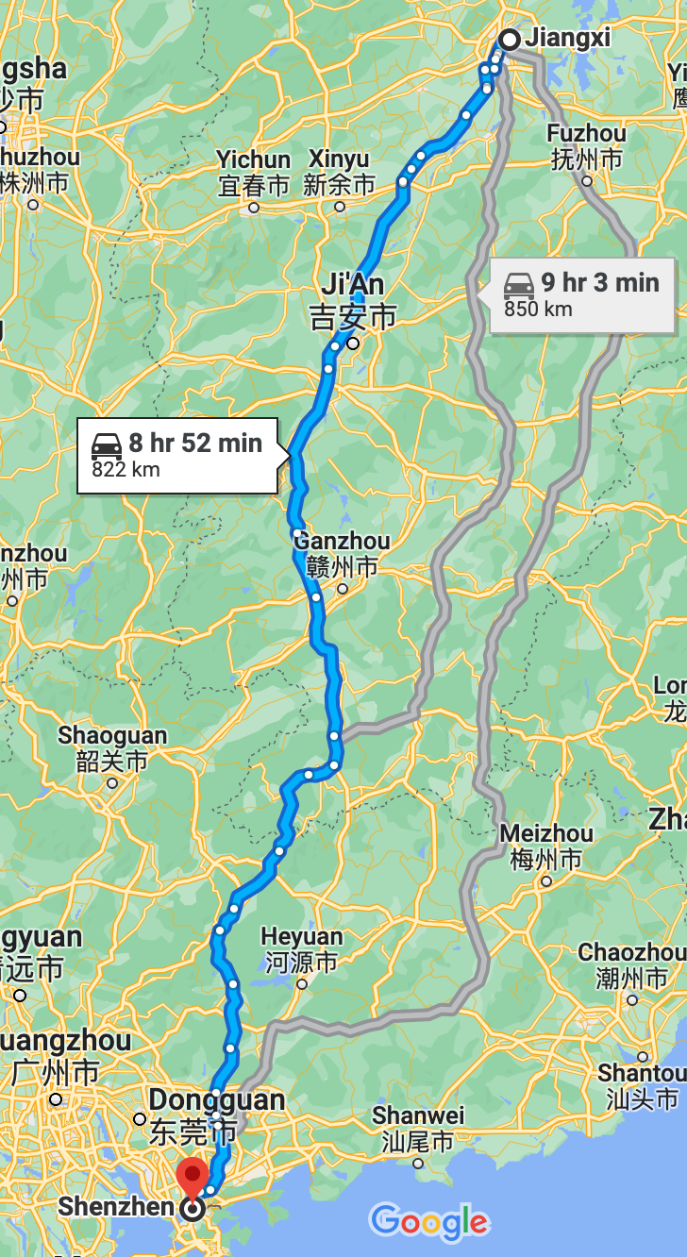
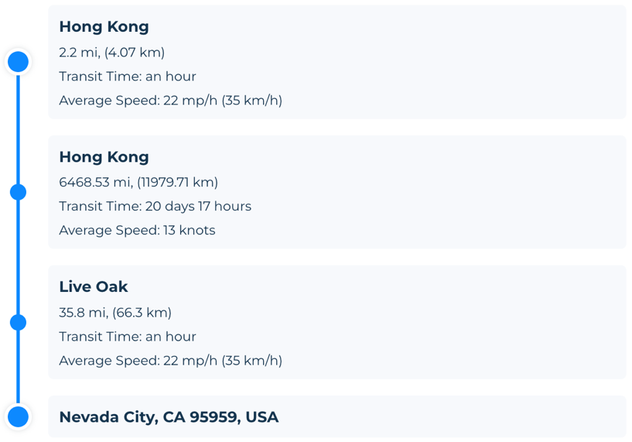

Transport – Lithium
Introduction
NCA Cathode Production
Remaining Production
Transport
Use Phase
End of Life
Economic Life Cycle Costing
Supplier | Location | Distance | Transport | Emissions | Total Emissions
Ganfeng Lithium | Mahong Factory, Jiangxi province to Hong Kong port | 850 km | Lorry | 1.81 Kg CO2 eq | 10.35 Kg CO2 eq
 | Hong Kong port to Nevada port | 11979 km | Sea Freight | 8.4 Kg CO2 eq
 | Nevada Port to City of Nevada | 66.3km | Lorry | 0.12 Kg CO2 eq
Notes:
Lithium is widely abundant in different parts of the world yet from Tesla’s suppliers, Ganfeng is Tesla’s main Lithium supplier, based in China. The main factory employed by Ganfeng is located in the Jiangxi province, from whicb the distance was calculated to one of the most transited cargo ports in China – Hong Kong. From here the distance was calculated using sea rates once again to Nevada.
The total emissions amounted to 10.33 Kg CO2, with sea freight being the main contributor
References:
Tesla (2021). Impact | Tesla United Kingdom. [online] Tesla. Available at: https://www.tesla.com/en_gb/impact.
www.ganfenglithium.com. (n.d.). Mahong Factory adds 50,000 tons of battery-grade lithium hydroxide annual production capacity. [online] Available at: http://www.ganfenglithium.com/new_detail_en/id/44.html.
www.ganfenglithium.com. (n.d.). Lithium Metals|Lithium Compounds--Ganfeng Lithium Co.,Ltd. [online] Available at: http://www.ganfenglithium.com/esg3_en.html.
cargofromchina.com. (n.d.). Shipping Routes from China | CFC. [online] Available at: https://cargofromchina.com/shipping-routes/.
Reuters (2021). China’s Ganfeng Lithium inks 3-year supply contract with Tesla. Reuters. [online] 1 Nov. Available at: https://www.reuters.com/business/autos-transportation/chinas-ganfeng-lithium-inks-lithium-battery-supply-contract-with-tesla-2021-11-01/.
DP World (2010). Distances & Time. [online] SeaRates. Available at: https://www.searates.com/services/distances-time/.
‌

Slide 17
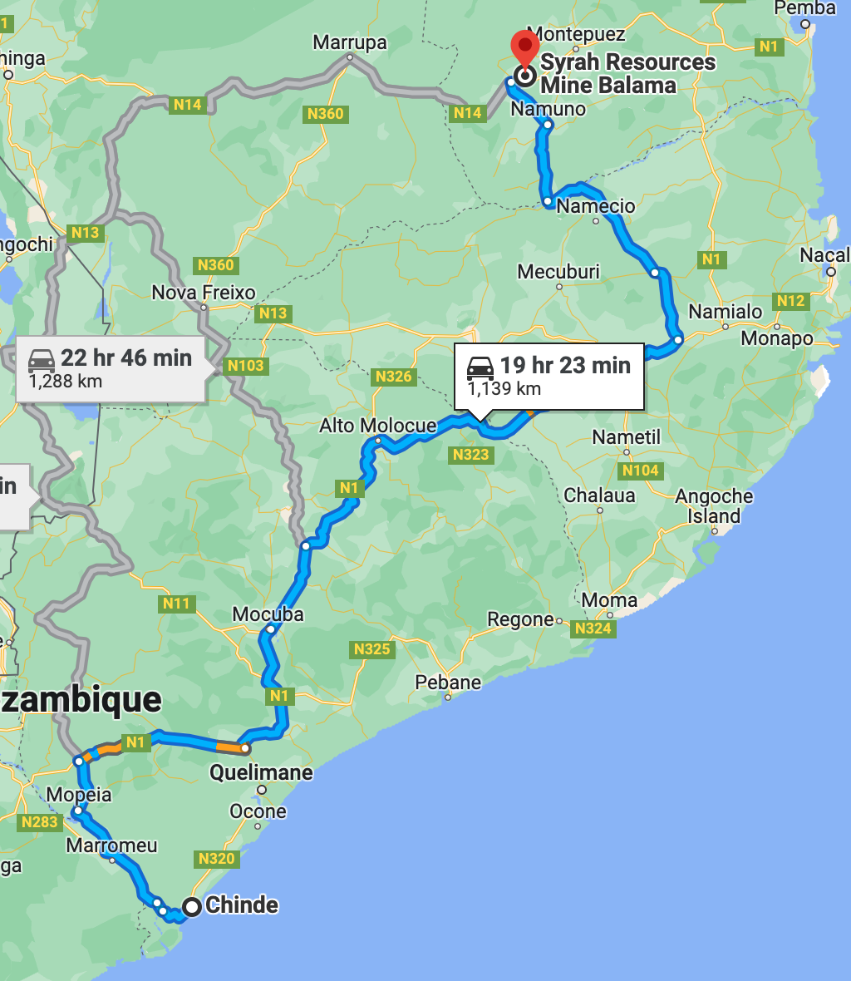
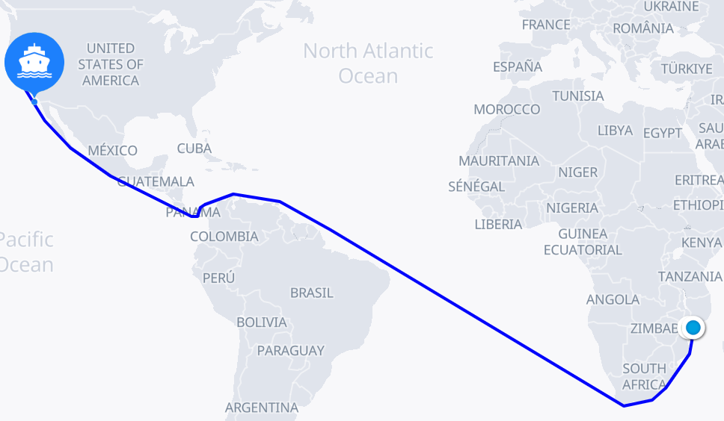
Transport – Graphite
Introduction
NCA Cathode Production
Remaining Production
Transport
Use Phase
End of Life
Economic Life Cycle Costing
Supplier | Location | Distance | Transport | Emissions | Total Emisisons
Syrah Resources | Cabo Delgado province to port of Chinde | 1139 km | Lorry | 7.94 Kg CO2 | 54.25 Kg CO2
 | Port of Chinde to Port of Nevada | 20888.84 km | Sea freight | 45.87 Kg CO2
 | Port of Nevada to City of Nevada | 66.3 km | Lorry | 0.44 Kg CO2
Notes:
For the graphite transport the point of origin from Tesla’s supplier, “Syrah Resources” resides in Mozambique. The first step was to identify Syrah’s extraction site, located in the Cabo Delgado province, from which the distance was calulcauted to Chinde’s port – the preferred point of transit chosen by Sea Rates to depart from Mozambique. From then, the graphite travels to the port of Nevada and once again to the city of Nevada through lorry.
Total amount of emissions = 53.81 kg
References:
Tesla (2021). Impact | Tesla United Kingdom. [online] Tesla. Available at: https://www.tesla.com/en_gb/impact.
DP World (2010). Distances & Time. [online] SeaRates. Available at: https://www.searates.com/services/distances-time/.
Lewis, M. (2022). A Louisiana graphite processing plant that supplies Tesla to get a $107M DOE loan. [online] Electrek. Available at: https://electrek.co/2022/04/19/a-louisiana-graphite-processing-plant-that-supplies-tesla-to-get-a-107m-doe-loan/ [Accessed 8 May 2023].
‌
China lockdowns helping Mozambique graphite, Syrah Resources says. (2022). Reuters. [online] 21 Jul. Available at: https://www.reuters.com/article/syrah-resources-mozambique-idINL8N2Z2364 [Accessed 19 Apr. 2023].
‌
Merano, M. (2022). Tesla supplier highlights graphite challenge for EV batteries [Editorial]. [online] TESLARATI. Available at: https://www.teslarati.com/tesla-graphite-supply-electric-vehicle-batteries/.
‌
‌

Slide 18
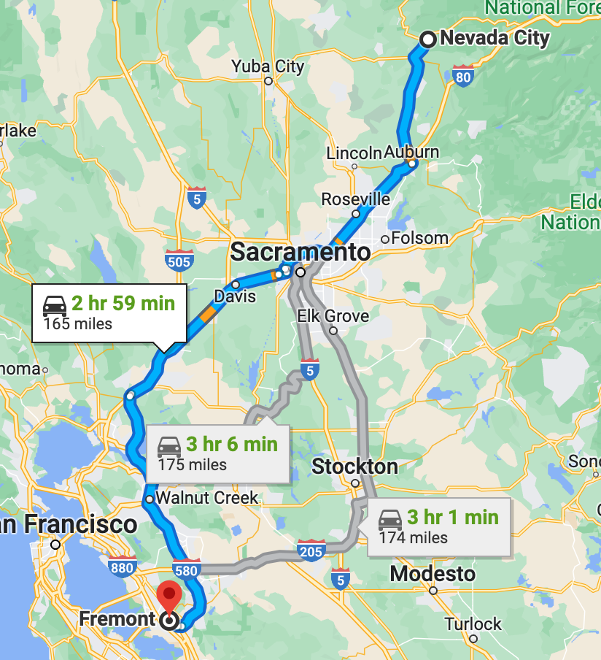
Transport of Battery Pack – Nevada to Fremont, CA
Introduction
NCA Cathode Production
Remaining Production
Transport
Use Phase
End of Life
Economic Life Cycle Costing
Supplier | Location | Distance | Transport | Emissions
Tesla | Nevada to Fremont, CA | 275.198 km | Lorry | 7.42 Kg CO2
Total emissions:
Nickel = 23.32 Kg CO2 eq
Cobalt = 5.59 Kg CO2 eq
Aluminium = 9.36 Kg CO2 eq
Lithium = 10.35 Kg CO2 eq
Graphite = 54.25 Kg CO2 eq
Transportation of Battery Pack =7.42 Kg CO2 eq
Total = 110.29 Kg CO2 eq
Notes:
This last stage encompassed the transportation of the battery pack as an entire final unit, from the production facility in Nevada to the factory in Fremont, California, for assemble within the cars, as per Tesla’s report states.
This trip it was assumed is performed through the use of lorry, given the shorter distance between both end points and poor rail infrastructure.
The emissions amount to 7.42 Kg of CO2 for the entire 478kg battery pack.
References:
‌
Tesla (2021). Impact | Tesla United Kingdom. [online] Tesla. Available at: https://www.tesla.com/en_gb/impact.

Slide 19
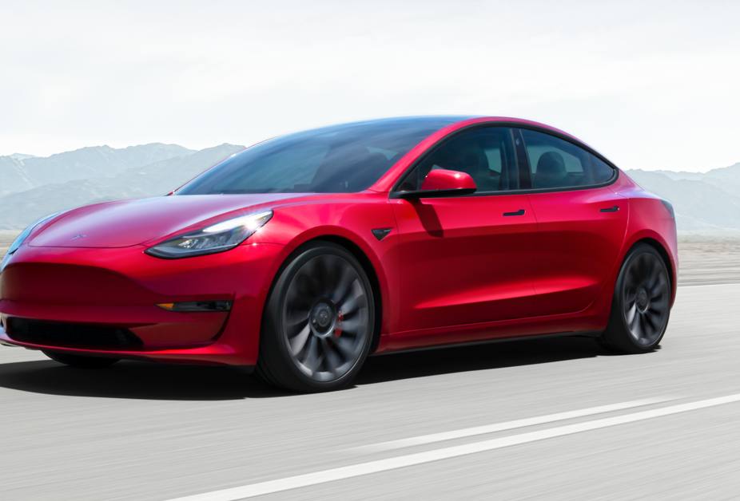
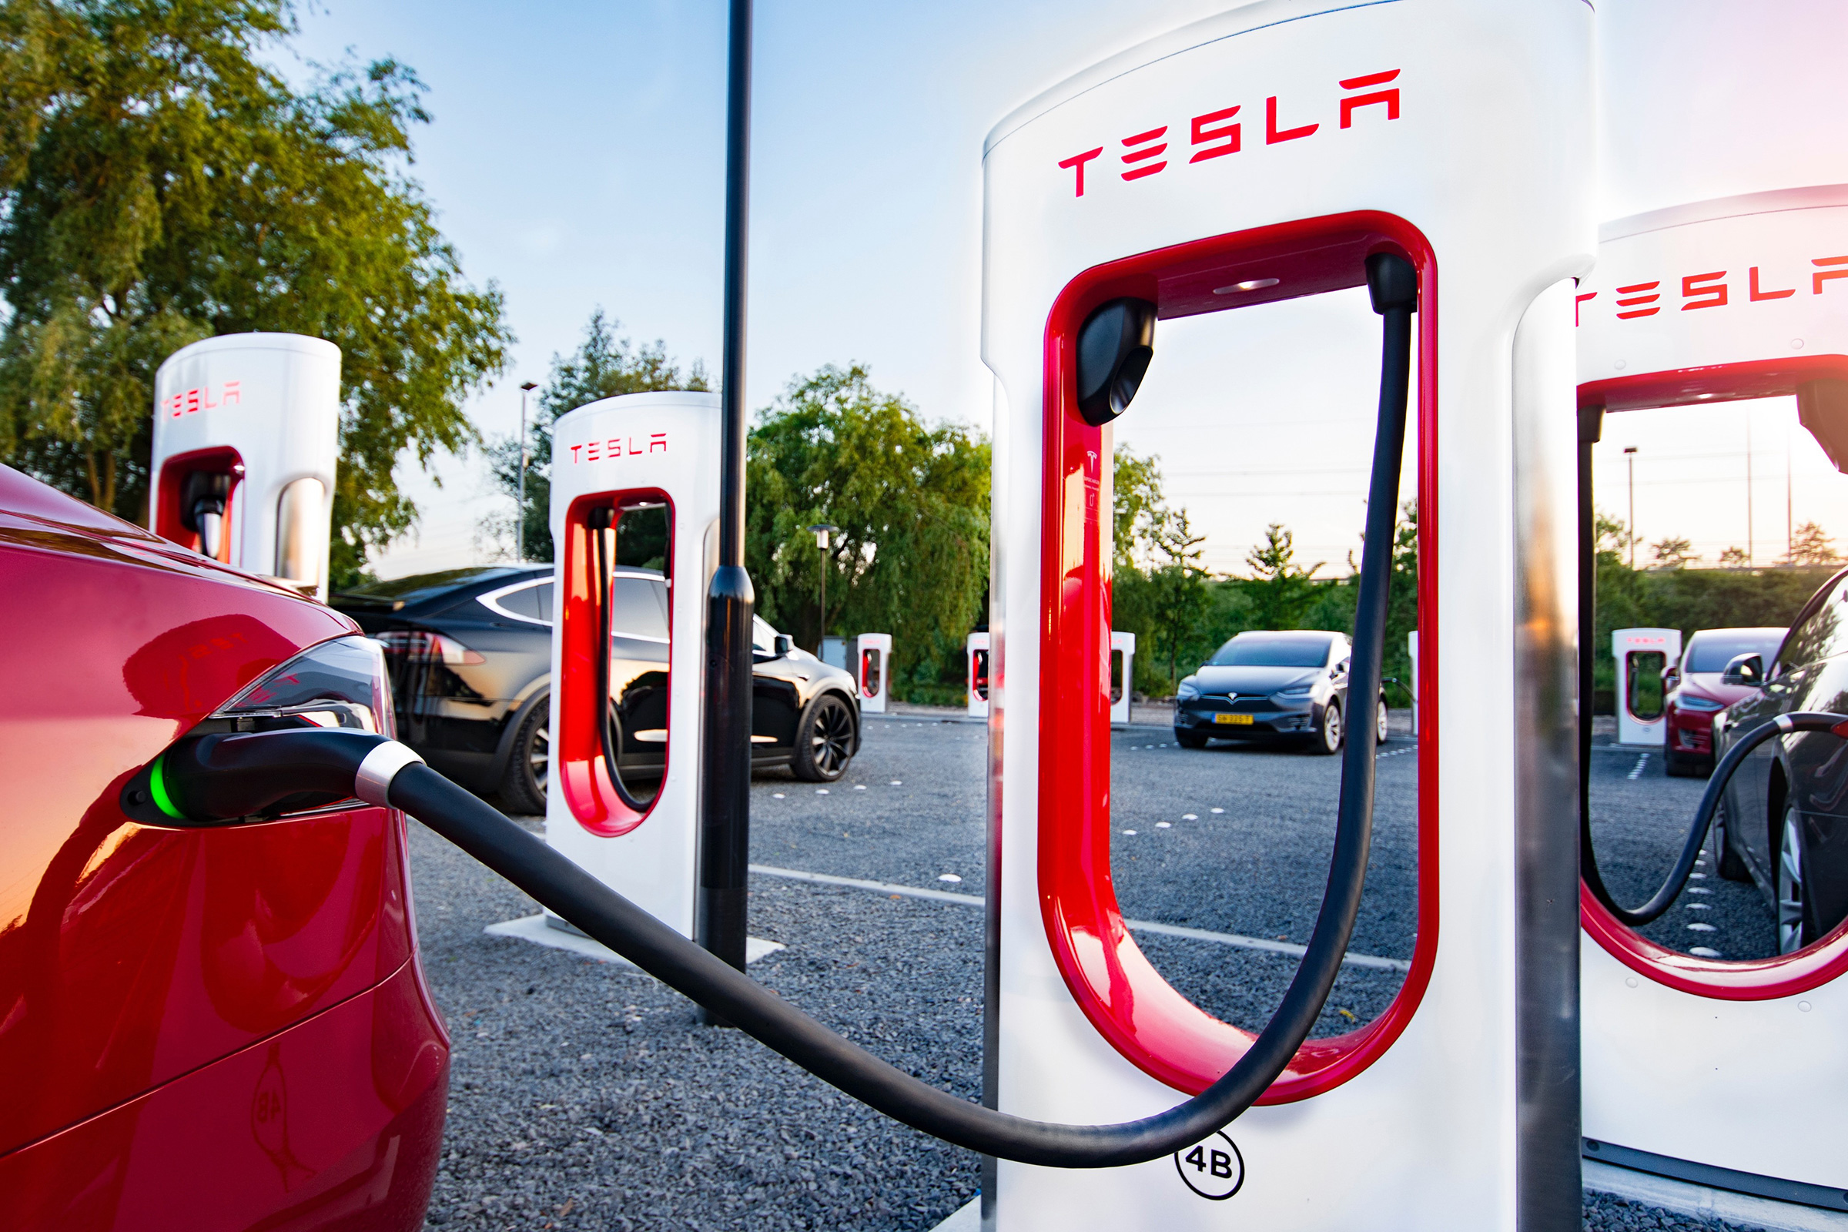
Use Phase

Slide 20

Use Phase
Introduction
NCA Cathode Production
Remaining Production
Transport
Use Phase
End of Life
Economic Life Cycle Costing
Electric Grid Mix
US Electric Grid - Energy Source | Billion KwH | Percentage of total
Biomass | 53 | 1%
Hard Coal | 828 | 20%
Hydro Power | 262 | 6%
Natural Gas | 1689 | 40%
Nuclear | 772 | 18%
Solar | 146 | 3%
Wind Power | 435 | 10%
Notes:
With this information, the battery pack itself and its emissions was the next step. We needed the amount of electricity consumed by the battery pack to then compare this to the electric grid.
First, the amount of Wh per km for a Tesla Model 3 – which is the car employing our 2170 NCA battery, were calculated. Then, the lifespan of the battery was needed, which Tesla estimates to outlast that of the car itself, between 23 – 35 years – so we made the assumption of 30 years, with around 1200 cycles.
Next, the average driver in the US is said to do around 13,500 miles a year which is equivalent to roughly 22000 km, with this information we can then find the amount of electricity consumed by the battery in its lifetime, done by multiplying the distance in a year by the consumption, and then this number by the 30 years of its lifetime.
With this number, we then created a new process denoted as Use Phase –with the input being the 99 million Wh’s of the battery pack consumed in its lifetime and the provider being the electric grid modelled.
As such, the emissions produced for the use of the battery pack within its lifetime amounted to 4.45 x 10^4 = 45500 kg CO2 emissions, with natural gas and hard coal being the main contributors with around 24000 and 20000 kg CO2 emissions
References:
www.eia.gov. (n.d.). Frequently Asked Questions (FAQs) - U.S. Energy Information Administration (EIA). [online] Available at: https://www.eia.gov/tools/faqs/faq.php?id=427&t=3#:~:text=About%2060%25%20of%20this%20electricity.
‌

Slide 21
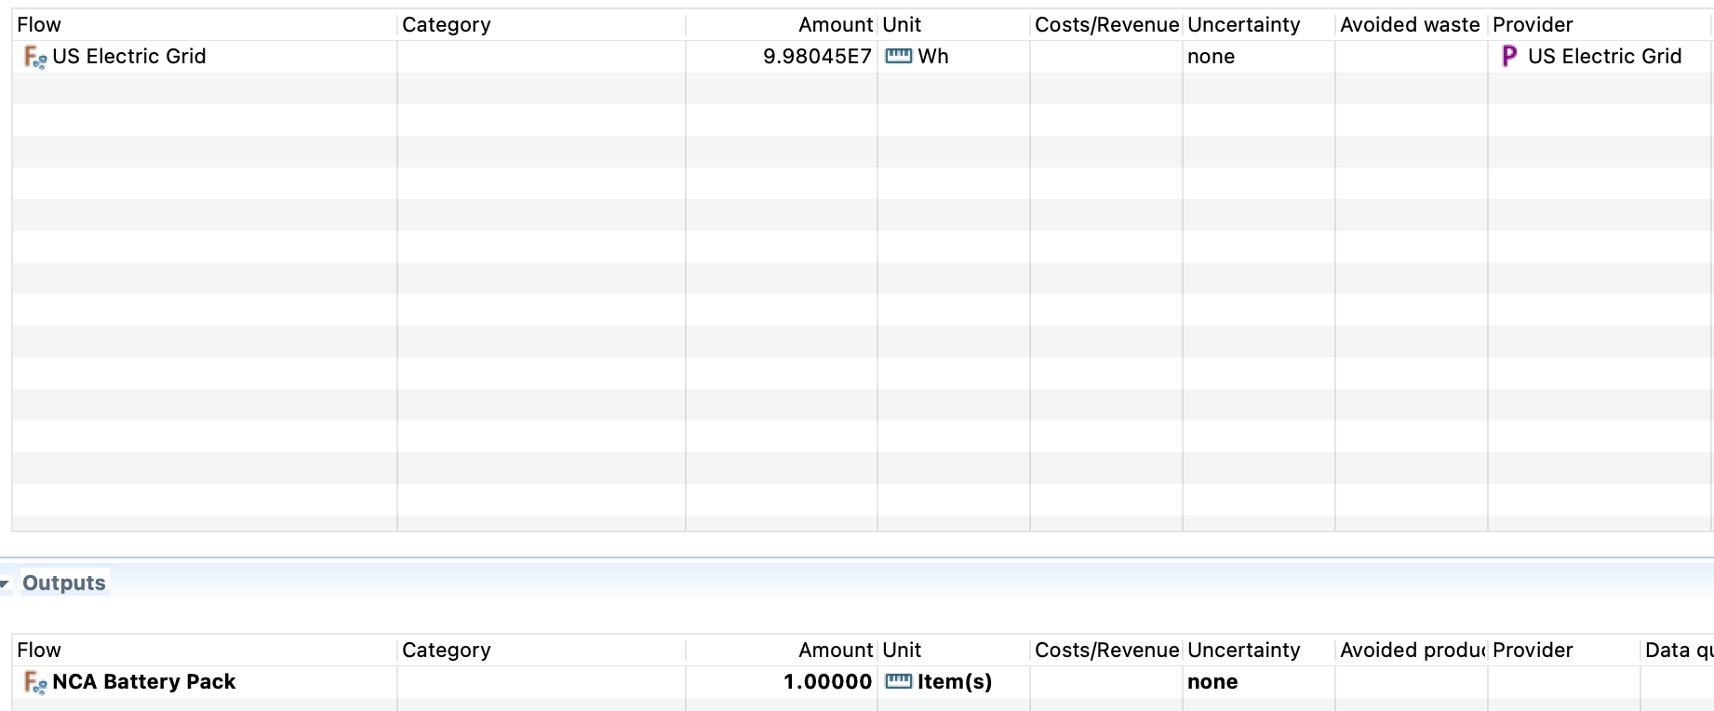
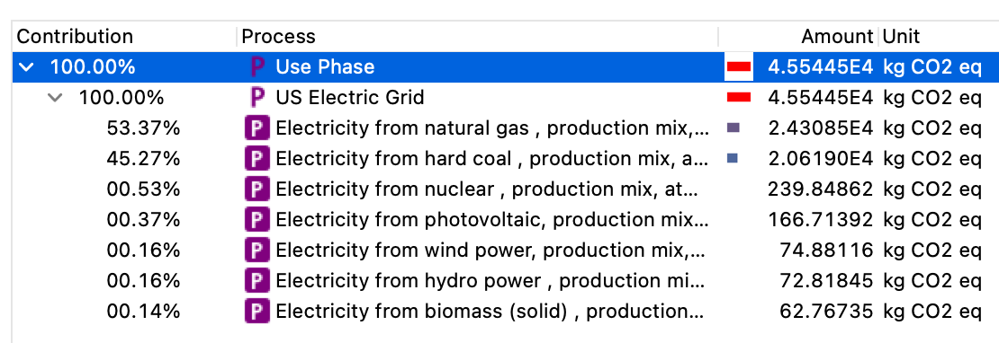
Use Phase
Introduction
NCA Cathode Production
Remaining Production
Transport
Use Phase
End of Life
Economic Life Cycle Costing
Breakdown
Electricity consumption of Tesla Model 3 = 245 Wh per mile / 1.6km
153.125 Wh per km
Time frame = 30 years
Average drive in US per year = 13,500 miles = 21726.144 km
Consumption of Battery Pack = 21726.144 x 153.124 =3,326,815.8 Wh
For 30 years = 30 x 3,326,815.8 = 99,804,474 Wh
Emissions = 0.46 kg x 3,326,816 = 1530 kg CO2
Total emissions – 1530 Kg CO2 eq
Notes:
With this information, the battery pack itself and its emissions was the next step. We needed the amount of electricity consumed by the battery pack to then compare this to the electric grid.
First, the amount of Wh per km for a Tesla Model 3 – which is the car employing our 2170 NCA battery, were calculated. Then, the lifespan of the battery was needed, which Tesla estimates to outlast that of the car itself, between 23 – 35 years – so we made the assumption of 30 years, with around 1200 cycles.
Next, the average driver in the US is said to do around 13,500 miles a year which is equivalent to roughly 22000 km, with this information we can then find the amount of electricity consumed by the battery in its lifetime, done by multiplying the distance in a year by the consumption, and then this number by the 30 years of its lifetime.
With this number, we then created a new process denoted as Use Phase –with the input being the 99 million Wh’s of the battery pack consumed in its lifetime and the provider being the electric grid modelled.
As such, the emissions produced for the use of the battery pack within its lifetime amounted to 4.45 x 10^4 = 45500 kg CO2 emissions, with natural gas and hard coal being the main contributors with around 24000 and 20000 kg CO2 emissions
References:
Car and Driver. (2023). What is Average Mileage Per Year? [online] Available at: https://www.caranddriver.com/auto-loans/a32880477/average-mileage-per-year/#:~:text=What%20Is%20the%20Average%20Mileage [Accessed 8 May 2023].
‌
Decker, B. (2022). How Long Does a Tesla Battery Last? [online] Lectron EV. Available at: https://ev-lectron.com/blogs/blog/how-long-does-a-tesla-battery-last.
‌
Tesla (2021). Impact | Tesla United Kingdom. [online] Tesla. Available at: https://www.tesla.com/en_gb/impact.

Slide 22
End Of Life

Slide 23
End of Life
Introduction
NCA Cathode Production
Remaining Production
Use Phase
Transport
End of Life
Economic Life Cycle Costing
Pyrolysis, Smelting and Hydrometallurgy identified
Assumption of 100% recycling based on Tesla claims
Based on in house recycling at Nevada gigafactory, transport of batteries discounted
Global warming potential calculated through OpenLCA to determine contribution of each stage
 | Pyrolysis | Smelting | Hydrometallurgy
Inputs | Spent, prepared battery Heat (0.56MJ/kg) | Degraded Metal Heat (1.32MJ/kg) | Cathode Powder Sulphuric Acid Heat (0.75MJ/kg)
Outputs | Degraded Metal Cathode Powder Mix Graphite | Aluminium Alloy Slag | Copper Sulphate Nickel Compounds Cobalt Residual Iron
By-products | Carbon Dioxide Carbon Monoxide Methane | Carbon Dioxide Carbon Monoxide Sulphur Dioxide Sulphuric Acid | Carbon Dioxide Wastewater
Notes:
Kam
References:
Nigel (2022). Specific Heat Capacity of Lithium Ion Cells. [online] Battery Design. Available at: https://www.batterydesign.net/specific-heat-capacity-of-lithium-ion-cells/. [Accessed 28/04/2023].
Dhawane, S.H., Al-Sakkari, E.G. and Yadav, D. (2022). Chapter 15 - Cost-effective viable solutions for existing technologies. [online] ScienceDirect. Available at: https://www.sciencedirect.com/science/article/abs/pii/B9780128243442000331 [Accessed 30/04/2023].
Tesla (2022. Impact Report 2022 [online]. Available at: https://www.tesla.com/ns_videos/2022-tesla-impact-report.pdf [Accessed 01/05/2023]
‌
‌

Slide 24
End of Life Impact Analysis
Introduction
NCA Cathode Production
Remaining Production
Use Phase
Transport
End of Life
Economic Life Cycle Costing
Notes:
Kam

Slide 25

Economic Life Cycle Costing – Key Raw Materials
Introduction
NCA Cathode Production
Remaining Production
Use Phase
Transport
End of Life
Economic Life Cycle Costing
Material Pricing | Mass (kg) | Cost per tonne | Material Cost | % of Total
Lithium | 37.28 | 36,342 | 1,354.83 | 35.45%
Graphite | 116.74 | 3,650 | 426.10 | 11.15%
Nickel | 65.09 | 23,000 | 1,497.07 | 39.17%
Aluminium | 46.90 | 2,335 | 109.51 | 2.87%
Cobalt | 12.44 | 34,930 | 434.53 | 11.37%
Total | 278.45 | 100,257 | 3,822.04 | 100.00%
Notes:
References:
Trading Economics (2023).
Trading Economics (2020)
tradingeconomics.com.
finanzen.net GmbH (2019)
‌Fastmarkets. (2023)

Slide 26
Summary
3507
Kg CO2 Eq.
Notes:
Kam

